Slide 1

Insurance POLICY MANAGEMENT
PRESENTED BY-
GROUP – 4

Slide 2
TEAM MEMBERS
ID | NAME
2498011 | Deepak Kumar Bindhani
2497778 | Rameshwar Subhash Waghmare
2498162 | Balaji Rajendra Davale
2498175 | S Ruhina Afreen
2498281 | Chinmayee Senapati
2498325 | Anuka X
2498339 | Ipsita Mishra
2498438 | Aishwarya G
2498463 | Martha Shivalika
2498468 | Vaikuntam Sunil Naidu

Slide 3
INDEX
Abstract
Objective
Introduction
Project Scope
Tools & Technologies
ER Diagram Of DB
Flow Diagram
Future and limitations
Advantages & Disadvantages
Output
Conclusion

Slide 4
ABSTRACT
The Government of India made history on October24,2000 by once again bringing back insurance business to private companies, which had earlier been abolished 24 years ago. The opening of the insurance sector was facilitated through the Insurance Regulatory and Development Authority (IRDA).
Today, organizations are competing in complex business environments characterized by continuous changes in economic, social politico- legal and regulatory factors.
The insurance sector along with other elements of marketing, as well as financial infrastructure, have been touched and influenced by the process of liberalization and globalization in India.
Keywords: Strategic Insurance Management, Consumer Behivoiur

Slide 5
OBJECTIVE
The main objective is to build a secured, robust Insurance Management system where the policies are managed properly. All the Information of user, their policy, category of Insurance is maintained on a single platform.

Slide 6
INTRODUCTION
This Insurance Policy Management is all about providing financial safety to the individual. If we have proper application to access all the insurance related activity then it will be cheery on top.
In the web application, thee re majorly two roles, one is that of admin and customer .Admin responsibility is to view the user list ,add category of insurance and to make a policy, etc. Another, User who will be the customers who are going to buy the policy

Slide 7
PROJECT SCOPE
This Insurance Policy Management system is maintained in a single platform.
It will maintain all the records of entire policies at insurance policy.
This application automates manual tasks by managing all records.
It is a web-based application for maintaining records.

Slide 8
TECHNOLOGIES
Server Side: Spring Boot,Spring Cloud, Spring Data JPA
Back-end: MY SQL
Server: Tomcat 9.0
Devops: Docker, Git Hub
AWS

Slide 9
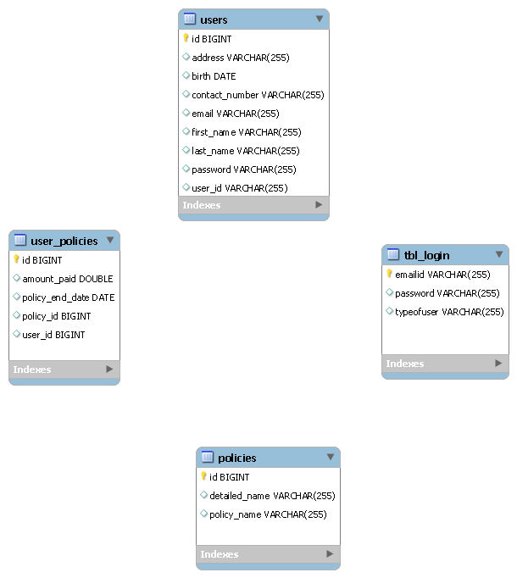
ER DIAGRAM OF DB

Slide 10
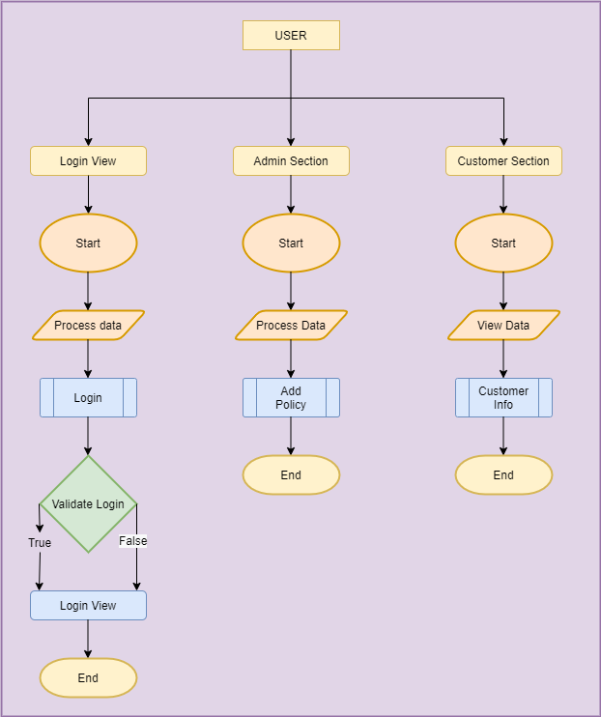
FLOW DIAGRAM

Slide 11
Limitations and Future Application of the project:
Future Enhancement:-
In Future, we can make add agent module in to project.
Limitation:-
In this, we cant’t send email to employee for the renewals of policy

Slide 12
ADVANTAGE
Covers Business Property
Replaces Income
Benefit of compensation
Tax Benefits
Financial support post retirement
smooth business operation

Slide 13
DISADVANTAGE
Denies Claims or Pays Slowly
Tricky terms and conditions
Lengthy legal formalities

Slide 14
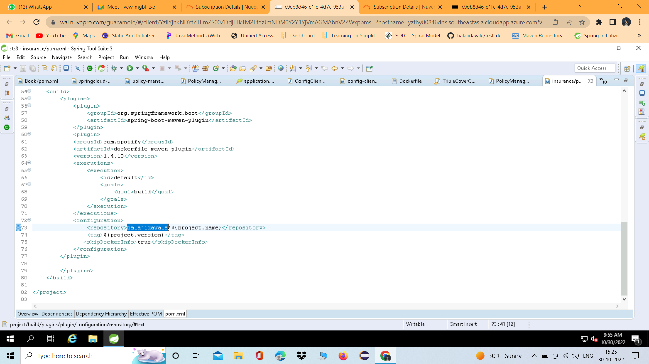
DOCKER

Slide 15
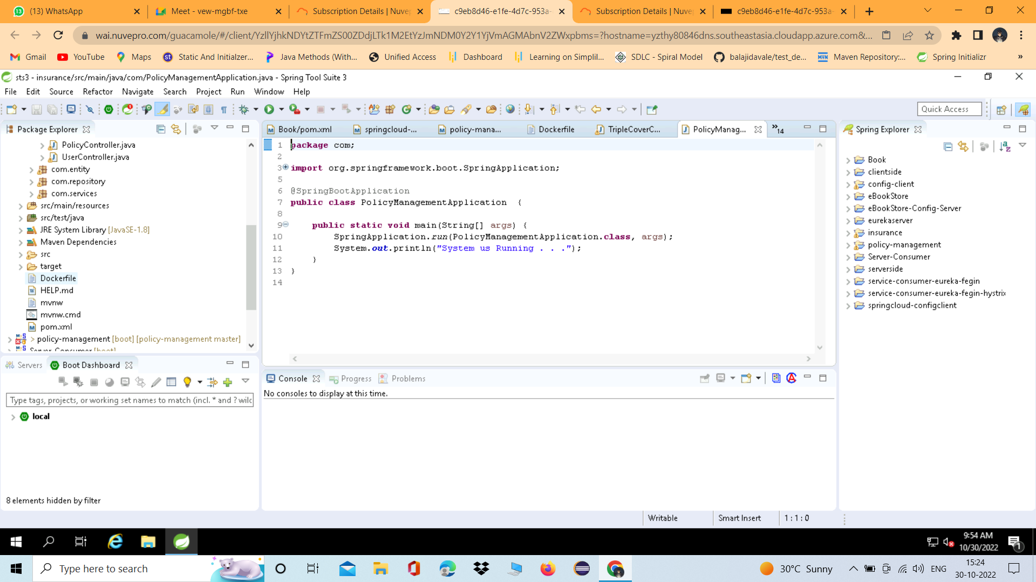

Slide 16
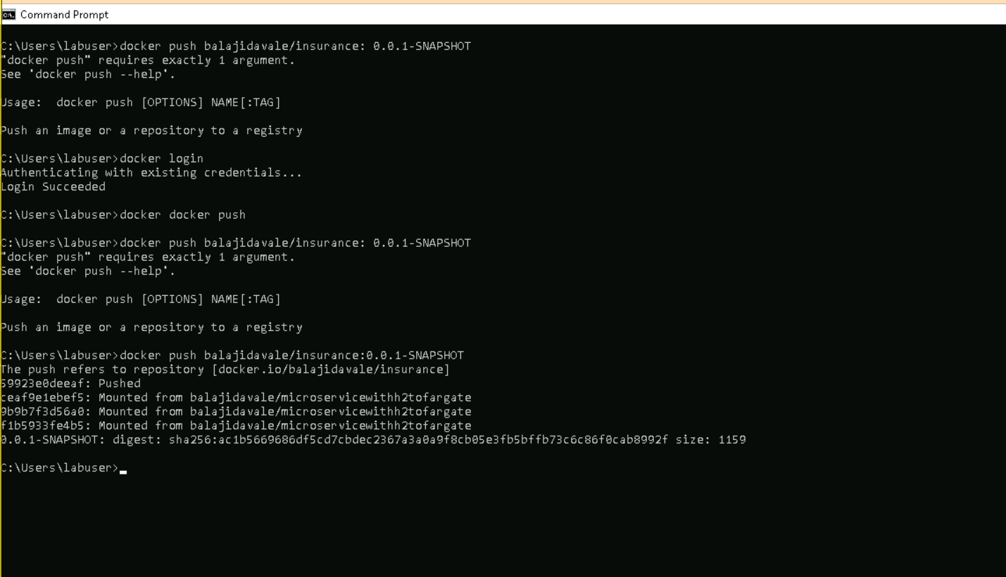

Slide 17
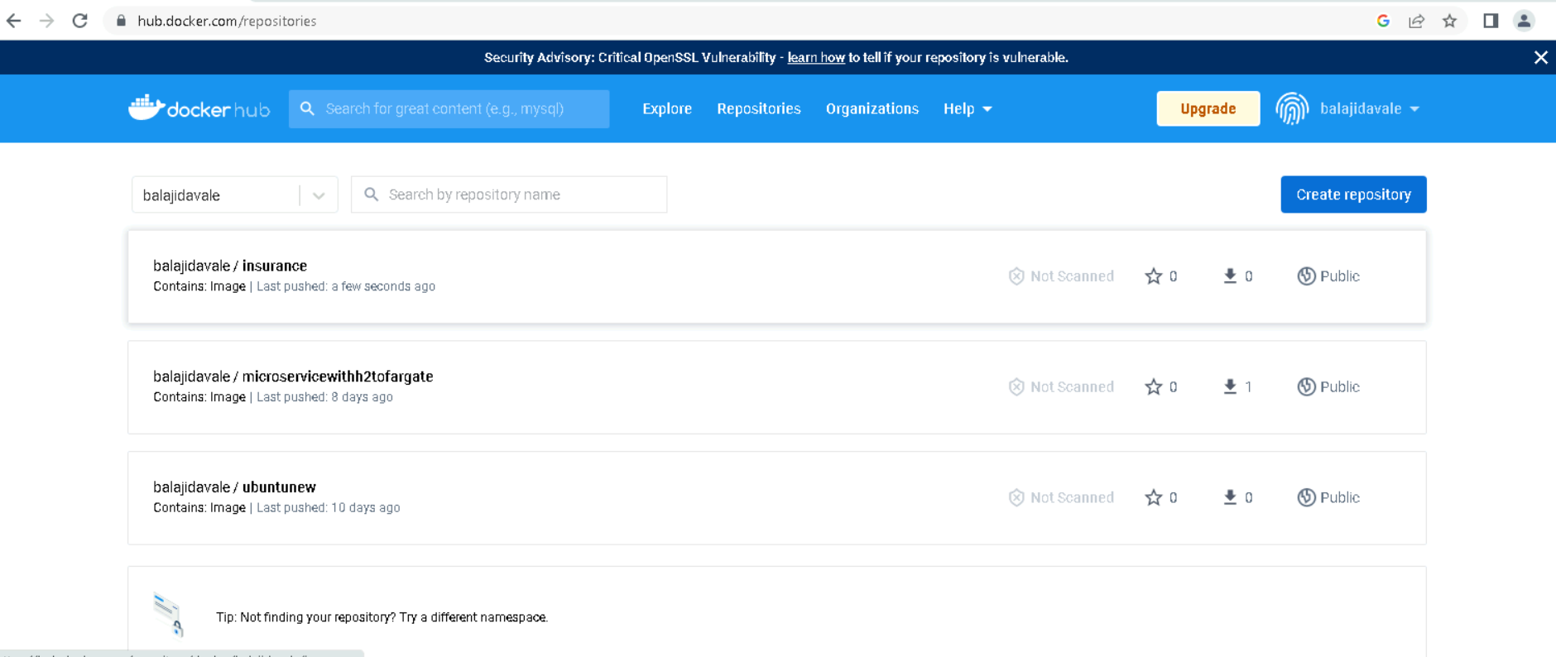

Slide 18
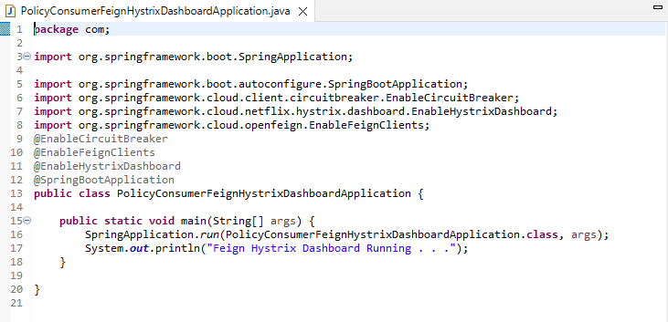

Slide 19
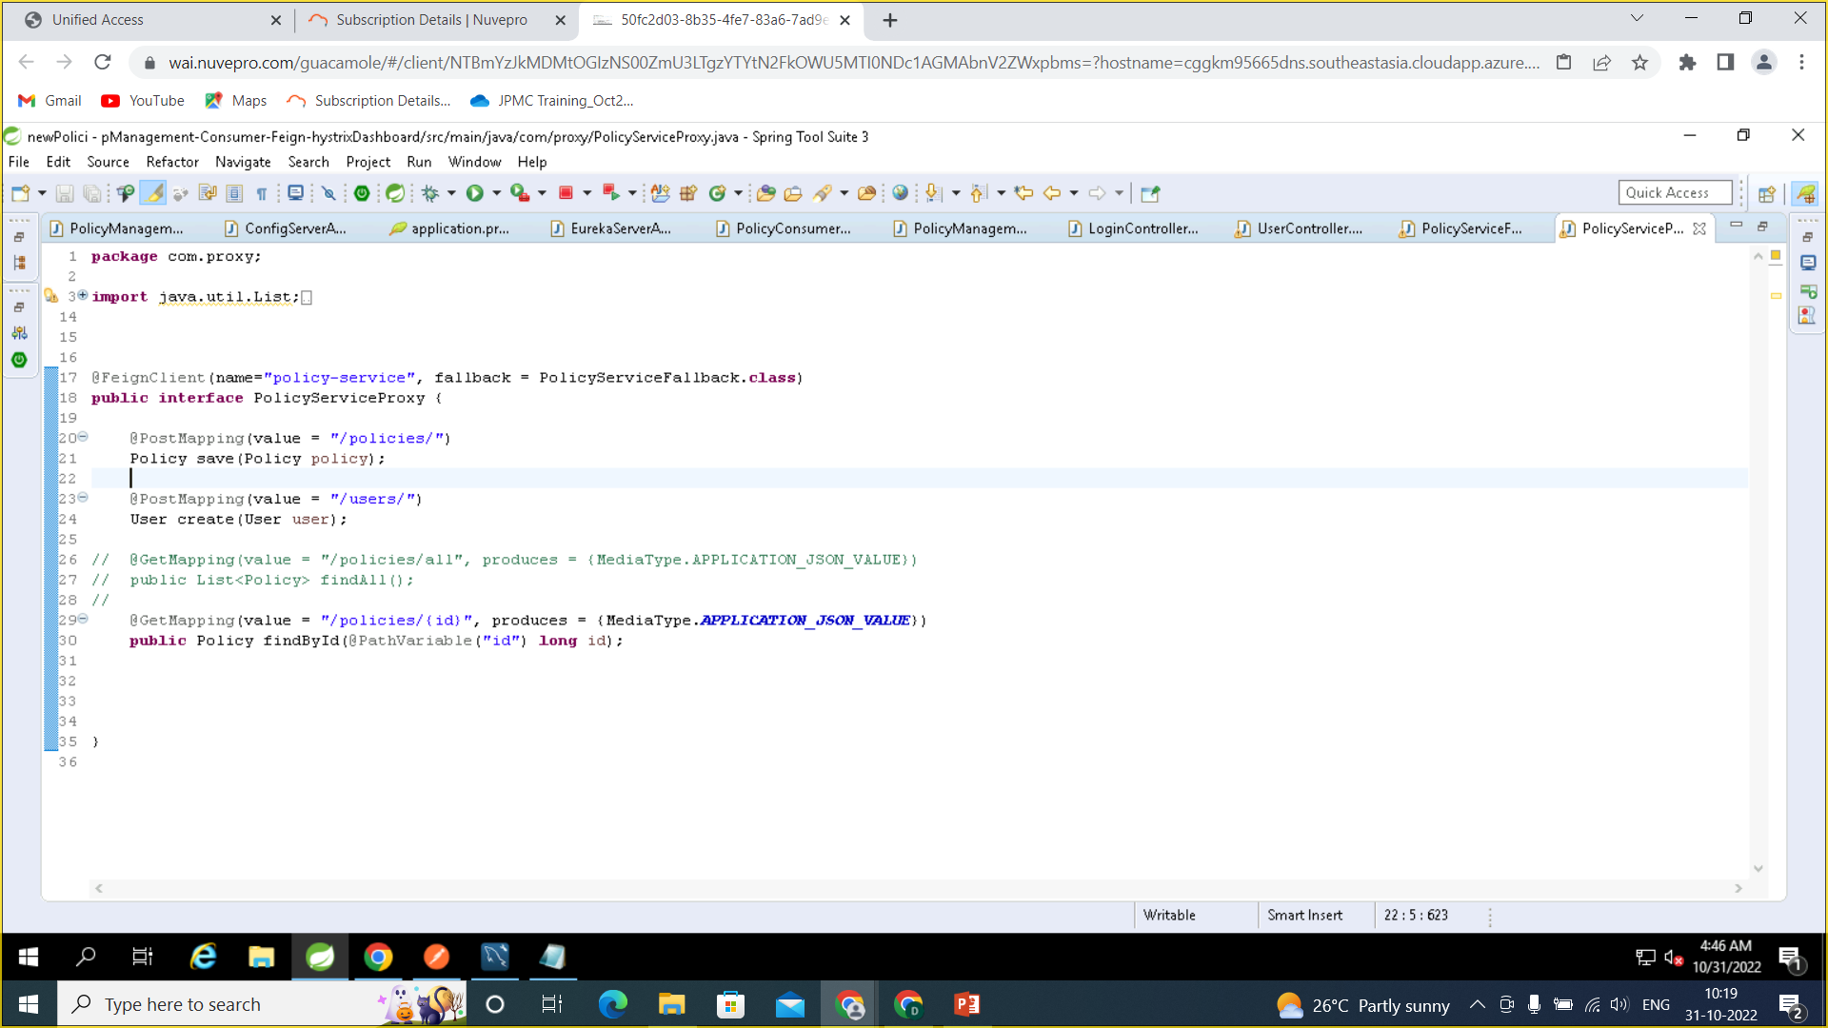

Slide 20
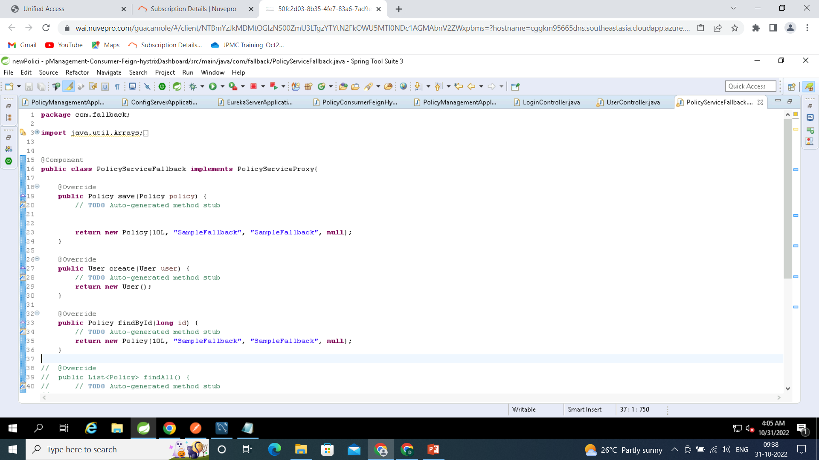

Slide 21
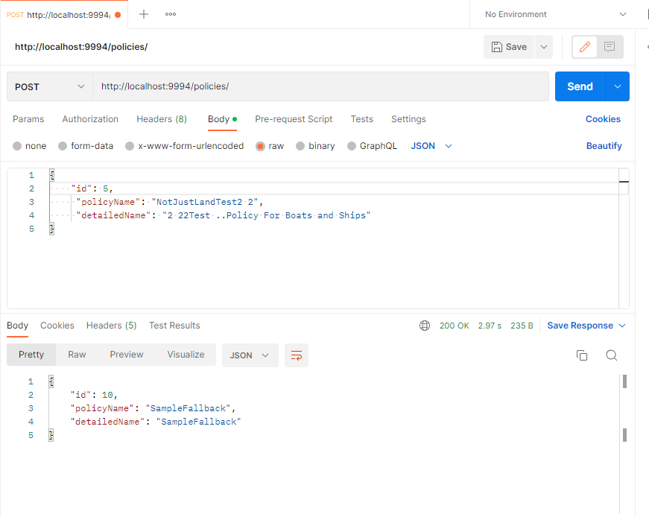

Slide 22
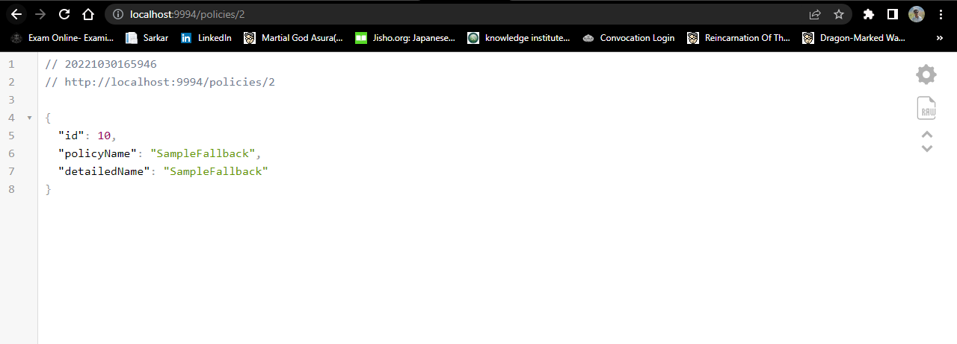

Slide 23
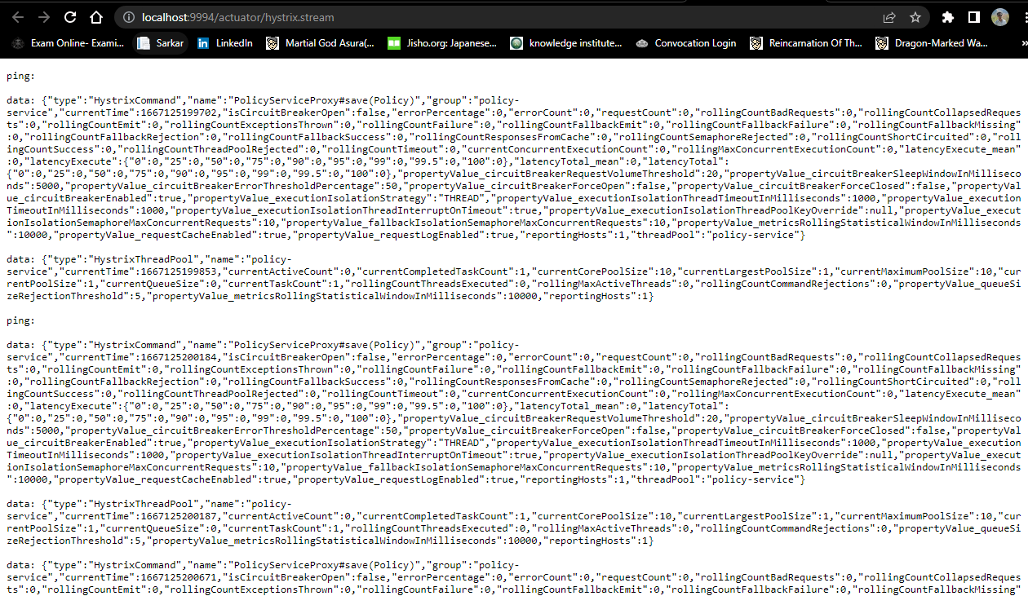

Slide 24
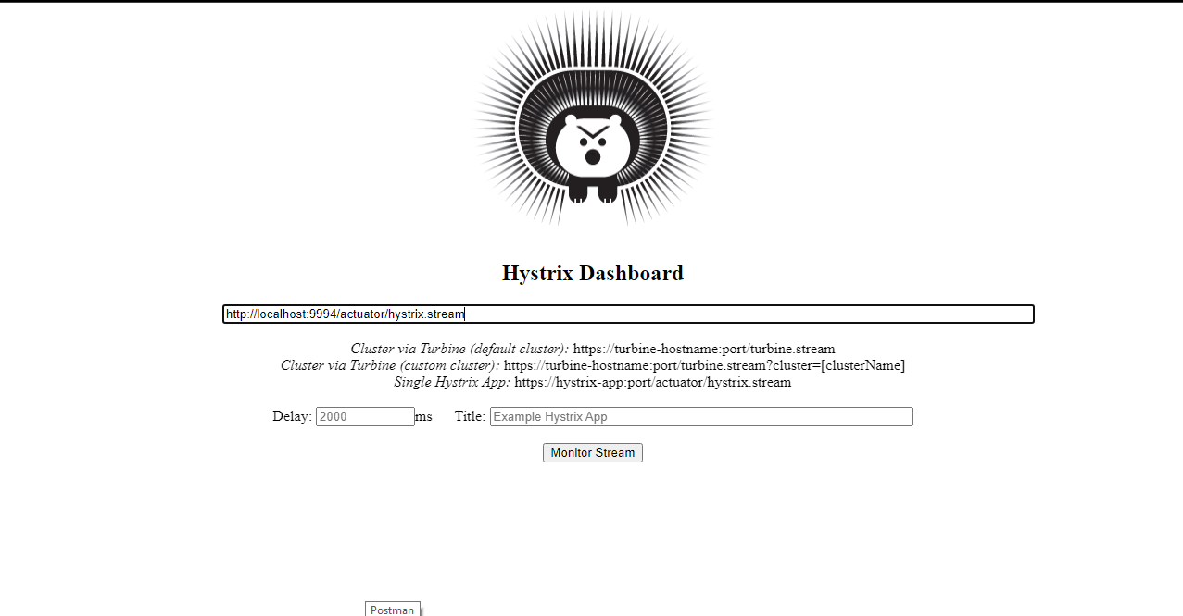

Slide 25
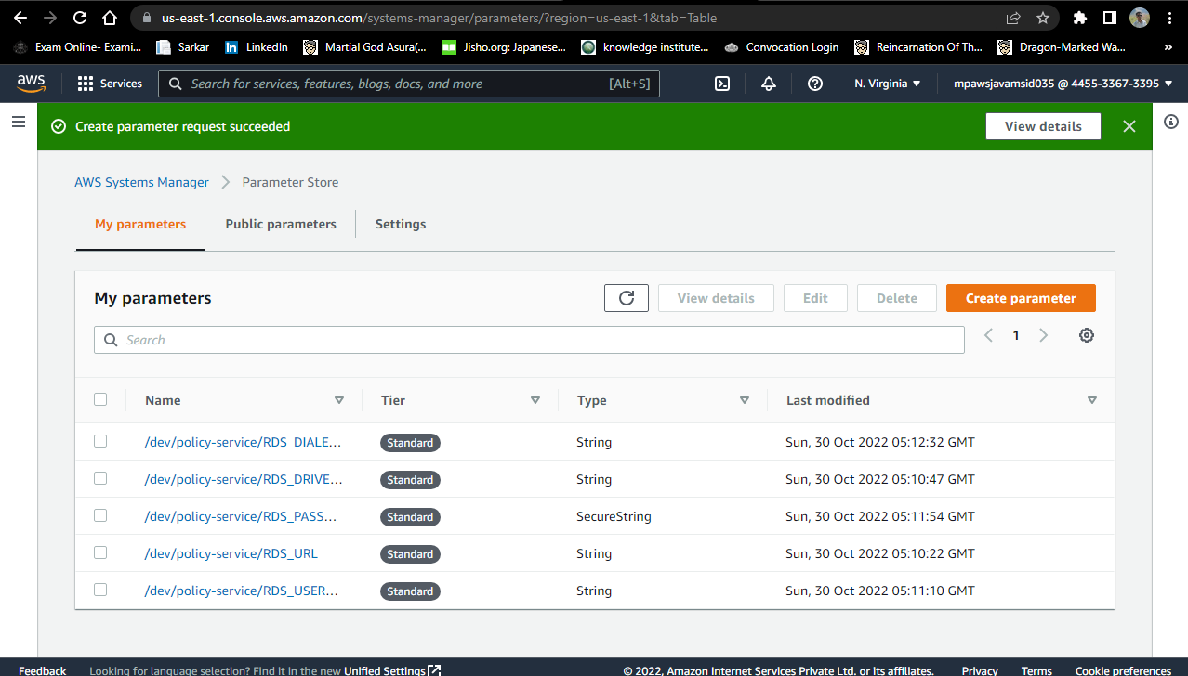
AWS

Slide 26
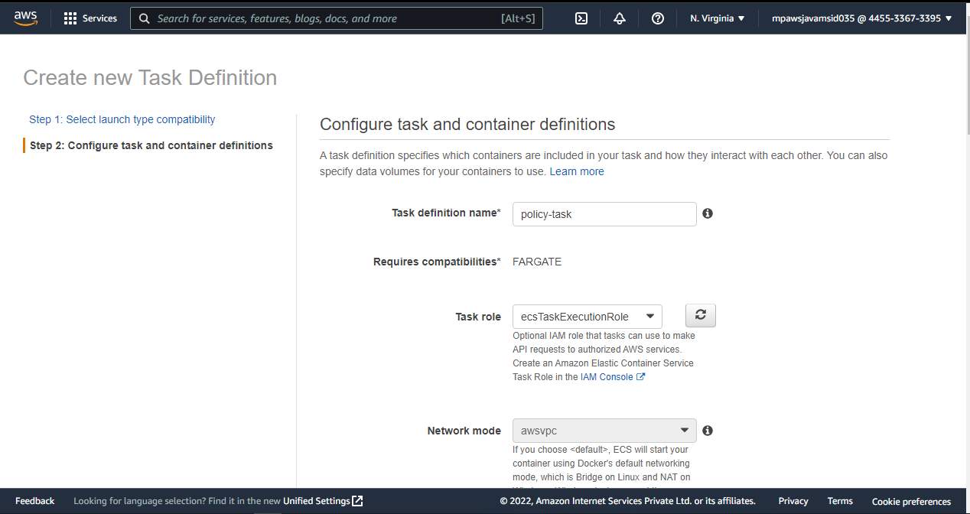

Slide 27
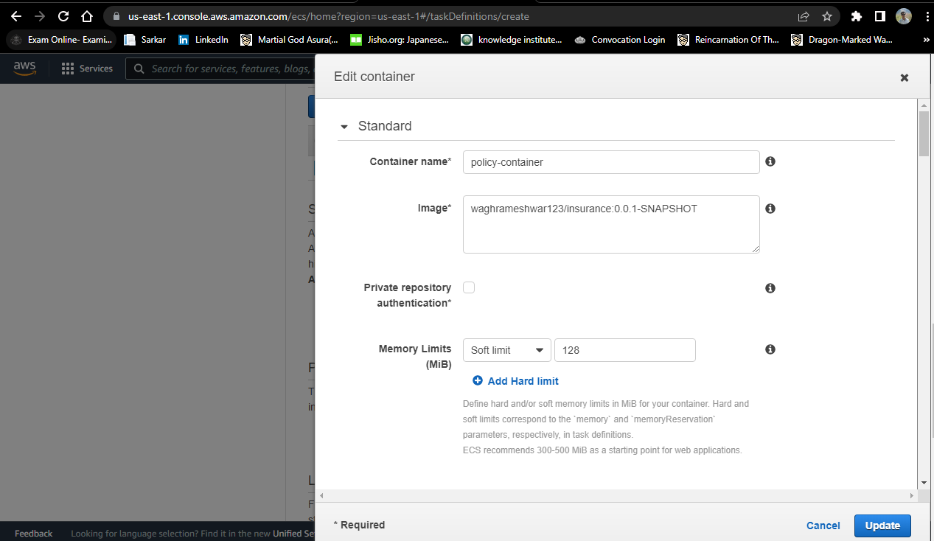

Slide 28
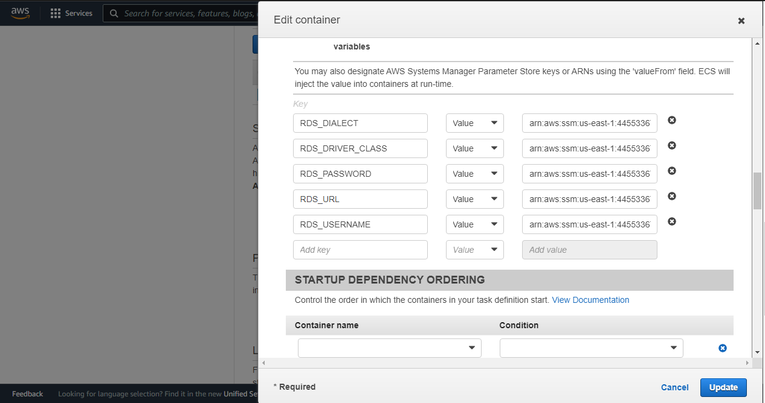

Slide 29
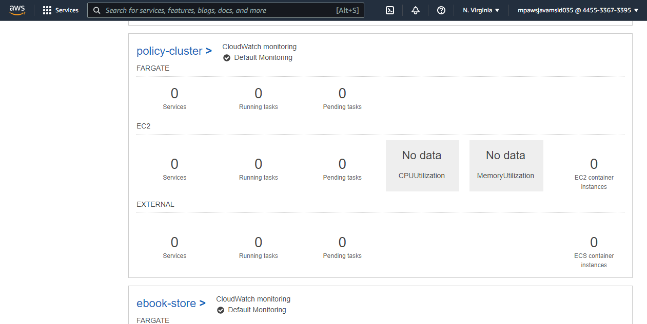

Slide 30
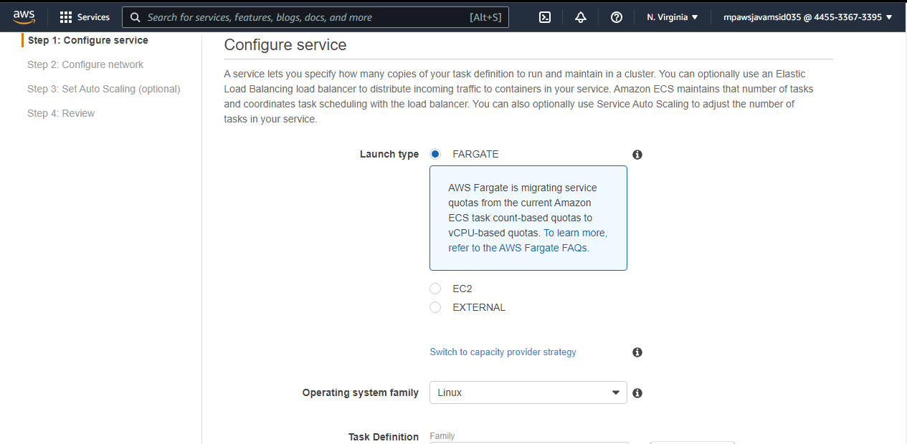

Slide 31
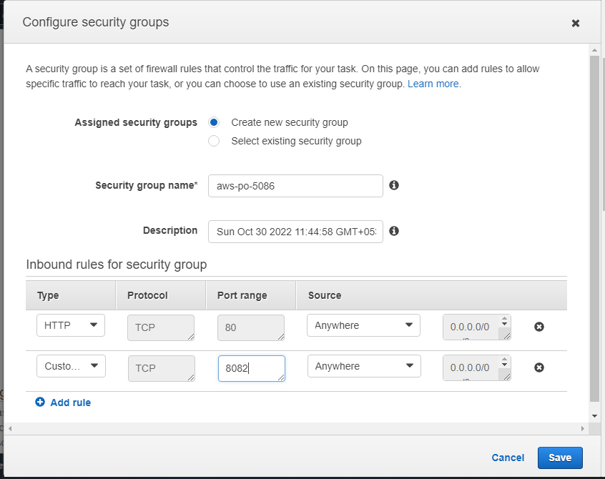

Slide 32
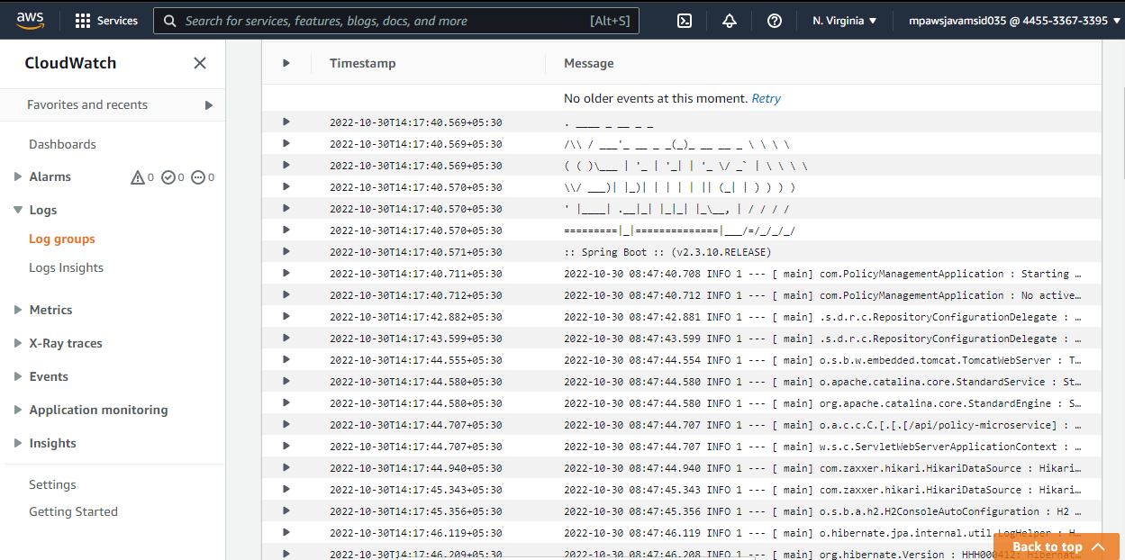

Slide 33
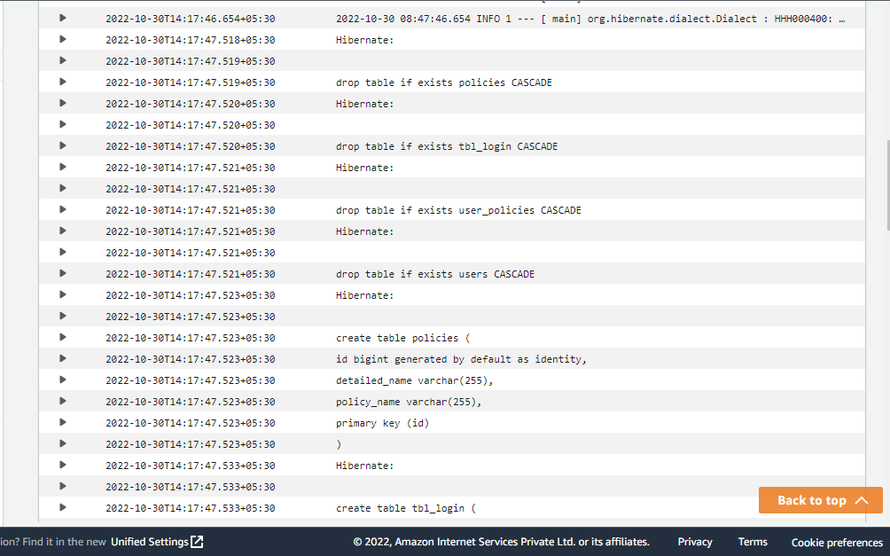

Slide 34
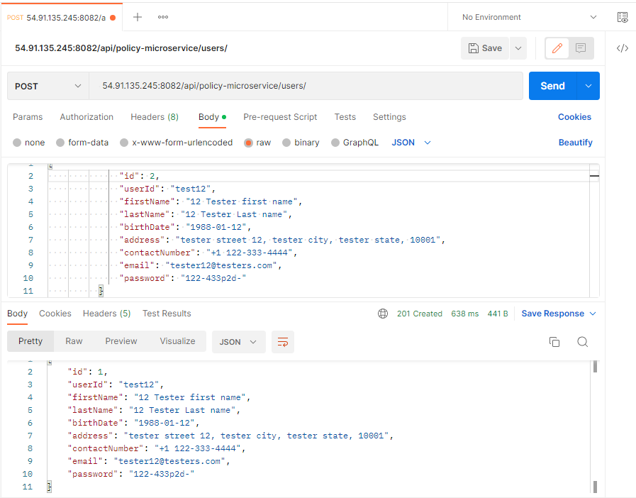

Slide 35
CONCLUSION
Insurance Policy Management helps us to keep the track of category of insurance, policies on a single platform. The project is developed to support all kinds of cutomers,With the help of this application, customer can buy the policy easily.
This Application is designed in such a way that any future modification can be done more easily.

Slide 36
THANK YOU

